Slide 1
Employee payroll system
S.Sai Sreekar
S.Sai Charan
Y.V.N Ashish​

Slide 2
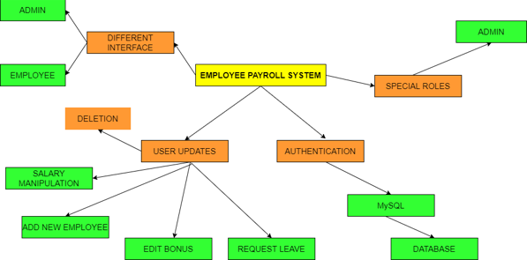
System architecture

Slide 3
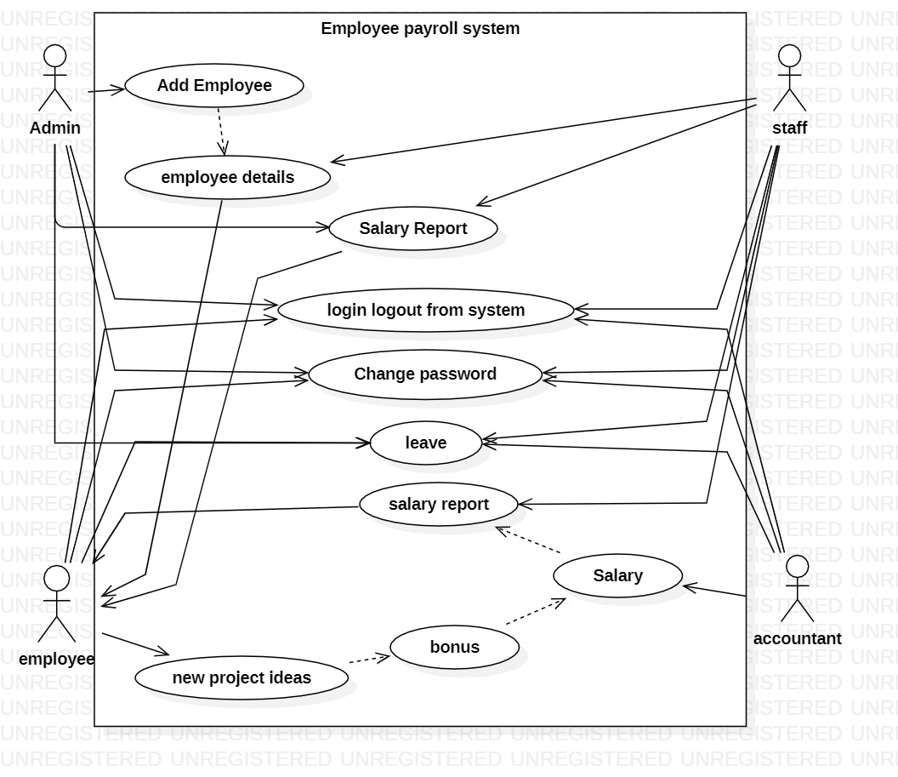
Use case diagram

Slide 4
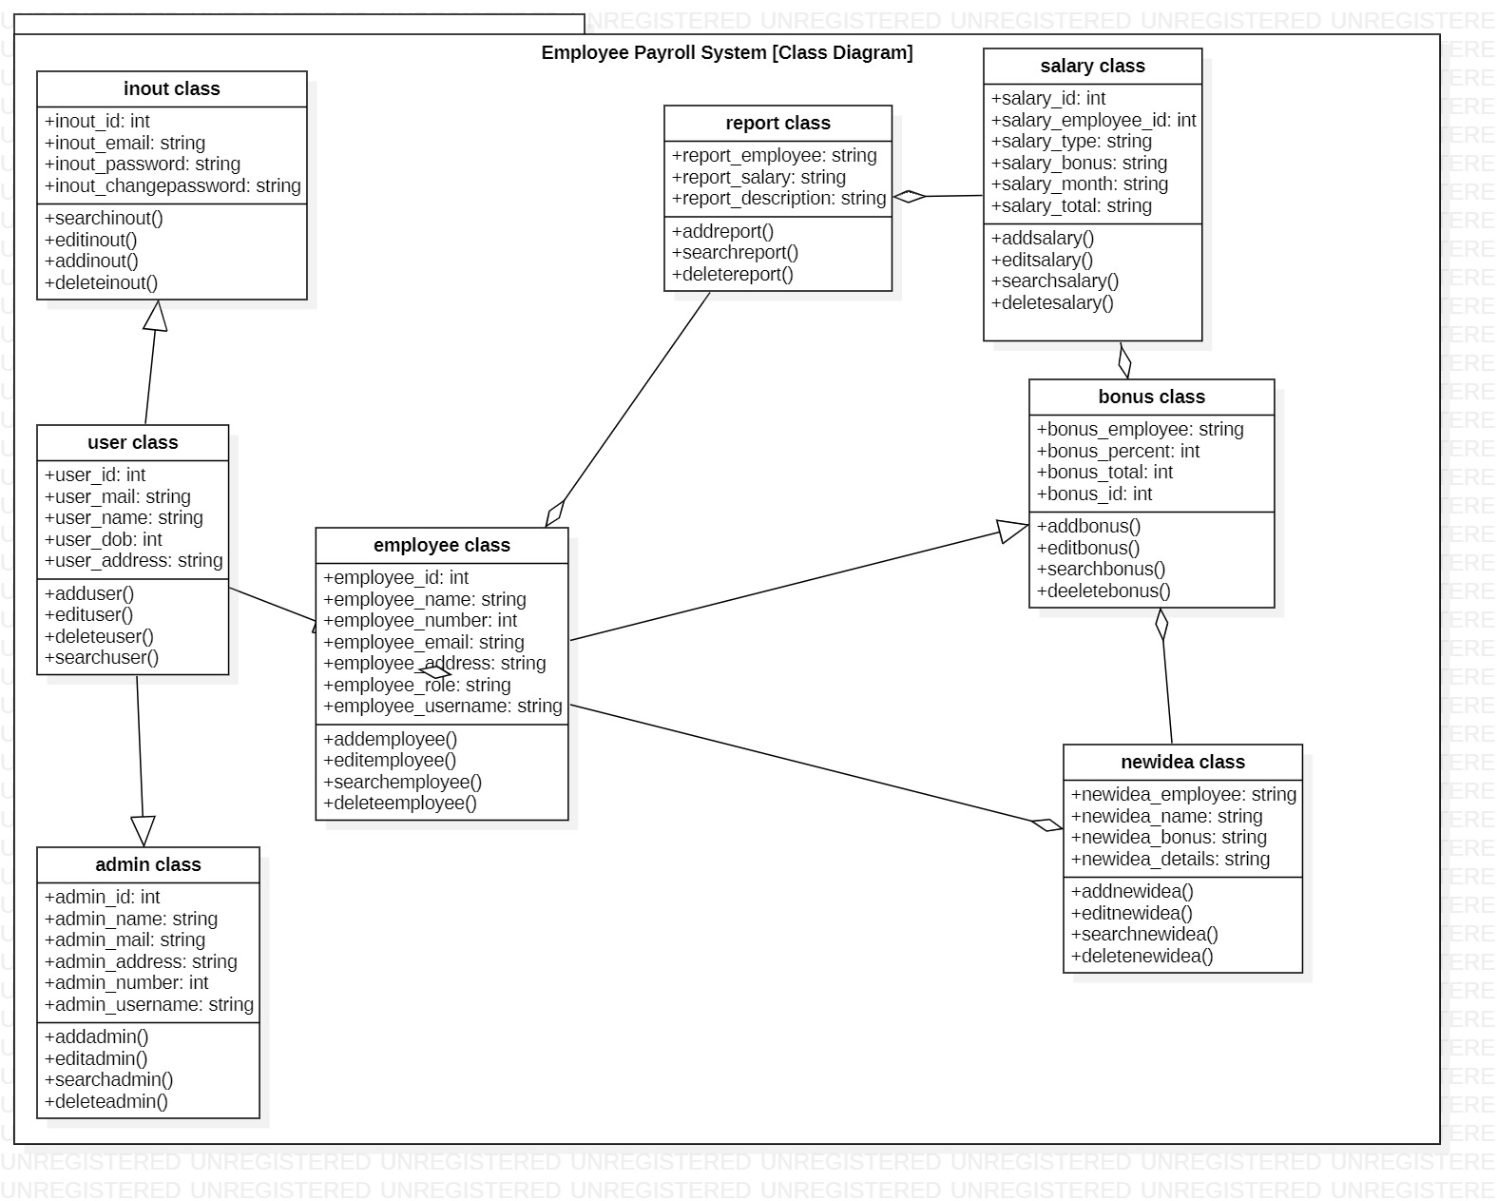
Class diagram

Slide 5
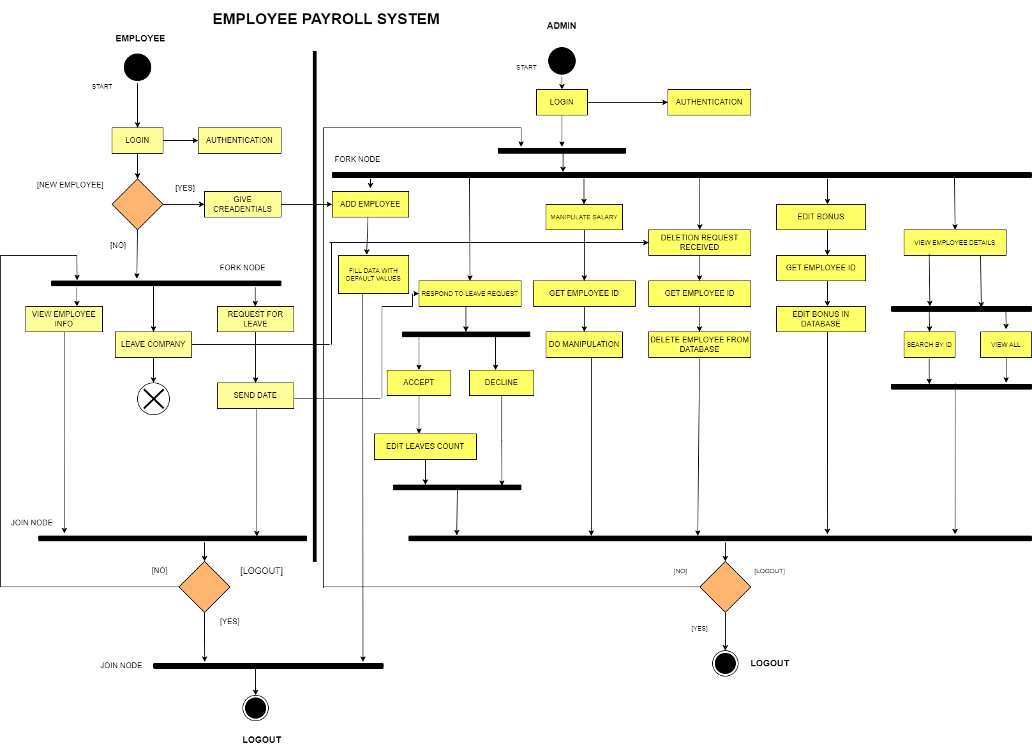
activity diagram

Slide 6
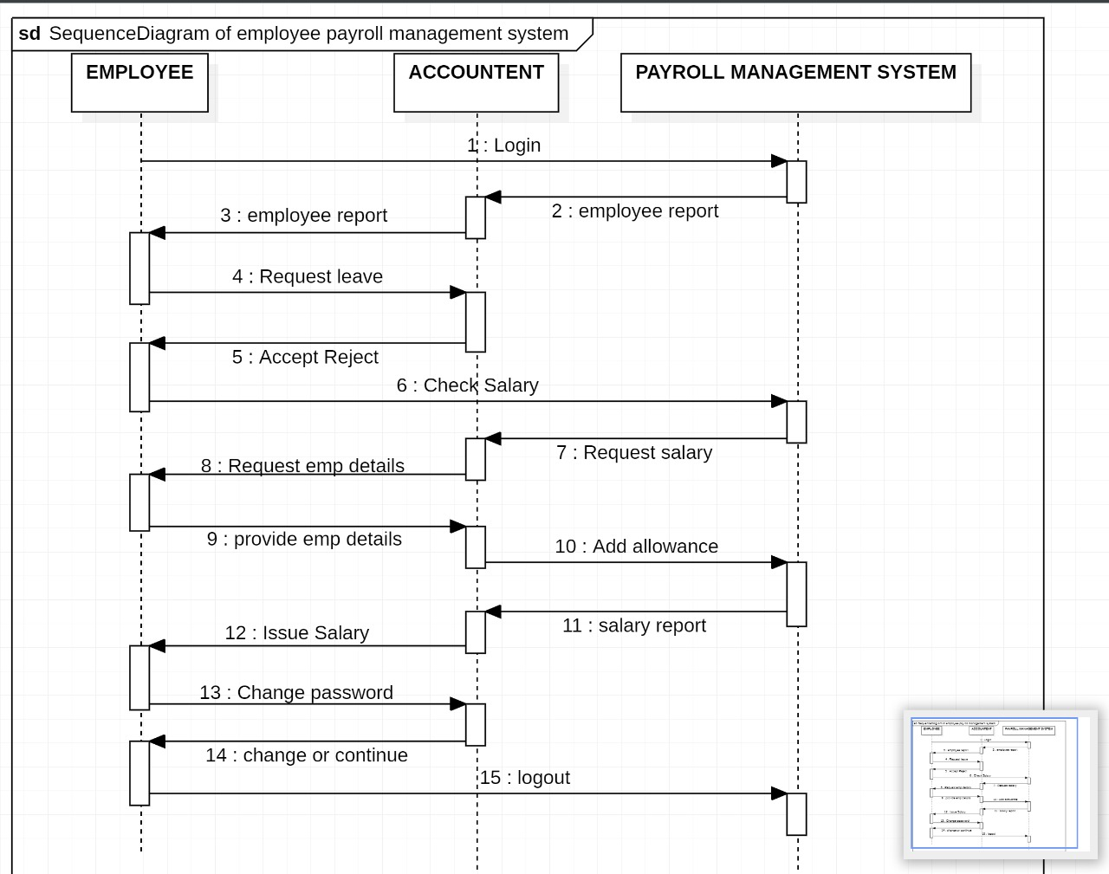
sequence diagram

Slide 7
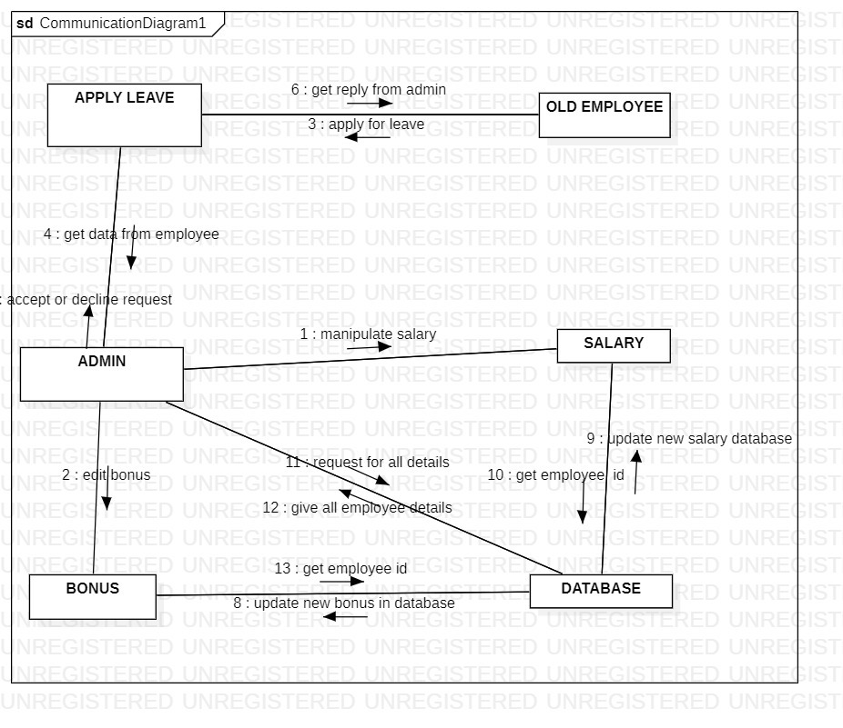
Collabration diagram

Slide 8
THANK YOU

